Slide 1

Advisory Committee for Environmental Sustainability (ACES)
2023 | 2024 Annual Report

Slide 2
Agenda
Focus Areas
Reusable Flatware Pilot
1
4
Sustainability Liaisons
Sustainable Design of New Schools
2
5
Composting Update
Solar PPA
3
6

Slide 3



Strategic Plan: Learning for All
VALUES
Equity
Excellence
Family and Community
Wellness
GOALS
Thriving Students
Affirming and Empowering Communities
Equitable, Transformative Resources
VISION
Our learners are engaged in authentic, challenging, and relevant learning experiences, becoming lifelong contributors and leaders in our dynamic and diverse society.
MISSION
Working together as a team, we will end the predictive value of race, class, gender, and special capacities for our children’s success through high-quality teaching and learning for all. We seek to build relationships with families and communities to ensure that every student succeeds.
We will know every student.

Slide 4
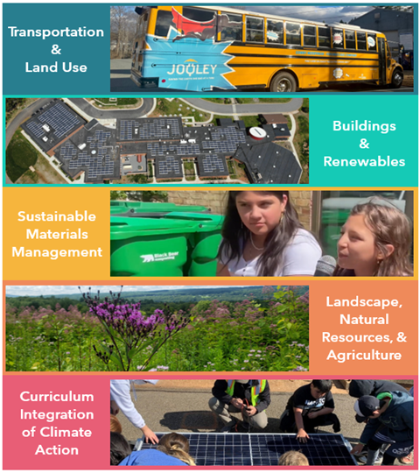
ACES Focus Areas
Focus Areas Defined in Climate Action Plan:
Transportation & Land Use
Buildings & Renewables
Sustainable Materials Management
Landscape, Natural Resources, & Agriculture
ACES Added:
Curriculum Integration of Climate Action

Slide 5

Sustainability Liaisons
First Cohort of 10 Liaisons in Spring 2024 with plan to expand to more schools in 2024/2025 school year
Liaisons are teachers, librarians, safety coaches, etc.
Funded by Grant Program for 2024/2025 school year, but will need budget funding to continue beyond that.

Slide 6
Sustainability Liaison Successes
Erikka Goff - MHS
Window clings on large media center windows to make them more visible to birds and to decrease bird collisions
Underclassmen litter pick-ups during SATs
Dimitra Aumiller - BWE
Vermicomposting projects in the learning garden
Take home compost bins for students & families
Awarded Allstate grant to purchase aquaponics system for school
Calder McLellan - MEL
Hosted clothing and toy swaps to reduce waste in community
‘Nude Food Fridays’ encouraged students to pack lunches with zero waste. School kitchen also participated.
Encouraged idling reduction for vehicles in student pickup line.

Slide 7
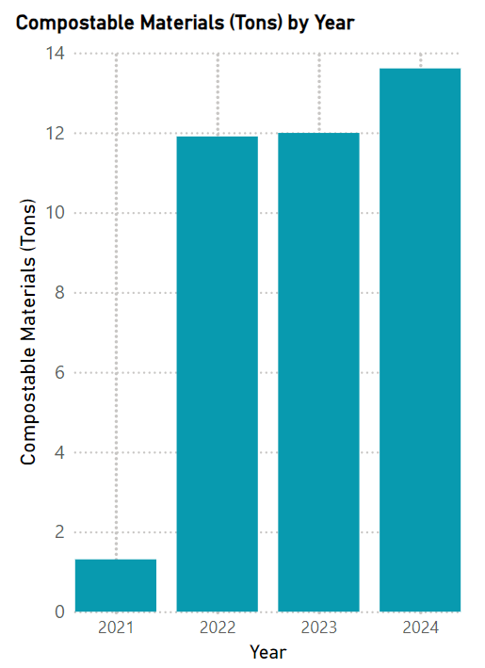
Composting Updates
ACES & SWAAC Volunteers + Sustainability Liaisons expanding cafeteria composting programs at several schools supported with classroom lessons.
More compost collected in first half of 2024 than any other year. 5.75 MT CO2 emissions avoided so far this year.
Child Nutrition increasing compostable serving ware for 24/25 school year.

Slide 8

Reusable Flatware Pilot
Composting is great, but waste reduction is ideal. ACES is committed to reducing waste in cafeterias.
ACES is very interested in conducting a reusable flatware pilot in a few schools
Students from Murray have been voiced their support of this initiation at School Board & ACES meetings.
Pilot would require budgetary funding due to cost of dishwashing labor. Expanding this initiative division wide would create staffing challenges.
Cost to conduct pilot at Murray is expected to be $2500.

Slide 9

Outdoor Lighting
Benefits:
Reduced Energy Use, GHG Emissions, & Cost
Reduced light pollution
Reduced Impact to Animals
Goals:
Retrofit Remaining fixtures to LED
All new construction complies with LEED Requirements
Convert lighting systems from photocell to BAS for improved control
Optimize functionality of existing fixtures
Future Goals:
Evaluate safety & security implications of reduced lighting schedule & implement

Slide 10
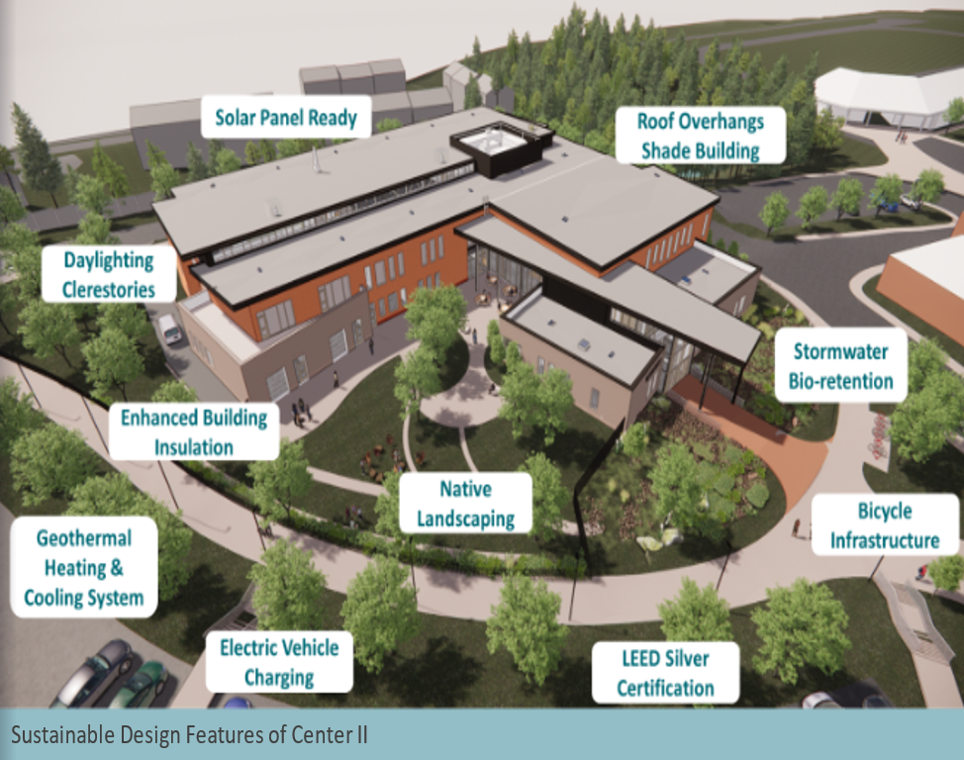
Sustainable Design of New Schools
Renewable Energy
Construction Waste Management
Daylighting
Protection & restoration of wildlife habitats
Optimization of energy efficiency
Electric Vehicle Charging

Slide 11
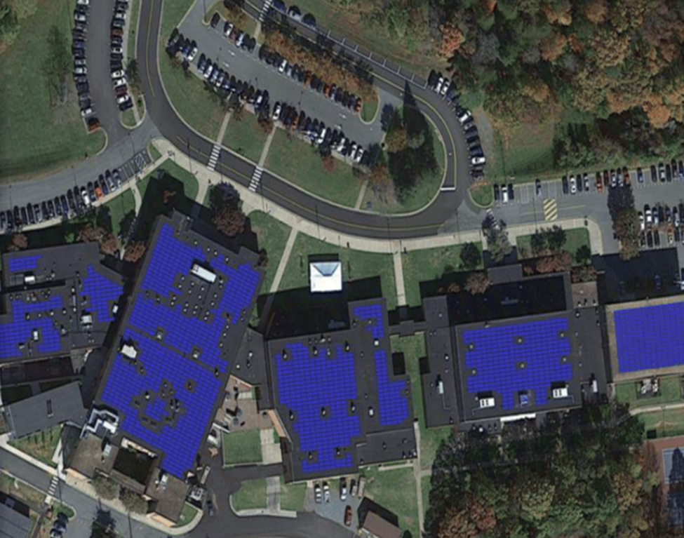
Solar Power Purchase Agreement

Slide 12
Solar PPA
How a PPA works:
ACPS leases roof space to a solar developer
Solar developer owns & installs photovoltaic panels on ACPS roofs at no upfront cost to the school division.
ACPS agrees to purchase energy from these systems at a predetermined rate that is typically more competitive than grid-purchased electricity for the 25-year term of the PPA
10
Schools
$10M Lifetime Savings
35% ACPS Electric Usage
4.9 Mega- watts
70K
GHG Emissions Avoided

Slide 13
Questions/Discussion

