Slide 1




Honoring Our Retirees
For the 2022-23 School Year

Slide 2

ELIZABETH AGEE
Crozet Elementary
Teacher

Slide 3
CYNTHIA ANDERSON
Stone Robinson Elementary
Office Associate

Slide 4
TANYA BAUGHER
Special Education Department
Special Education Assistant

Slide 5
TERESA BIBB
Special Education Department
Autism Assistant

Slide 6
KRISTEN BILLIES
Mountain View Elementary
Office Associate and Bookkeeper

Slide 7
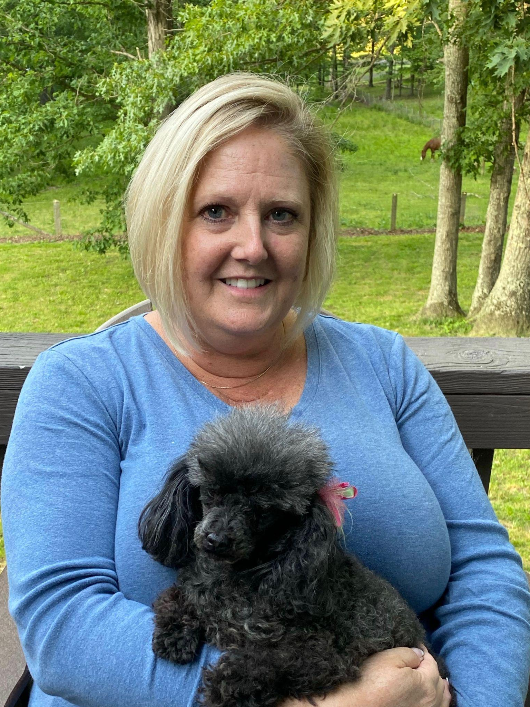
KIM BRANHAM
Department of Human Resources
HR Administrative & Financial Analyst

Slide 8
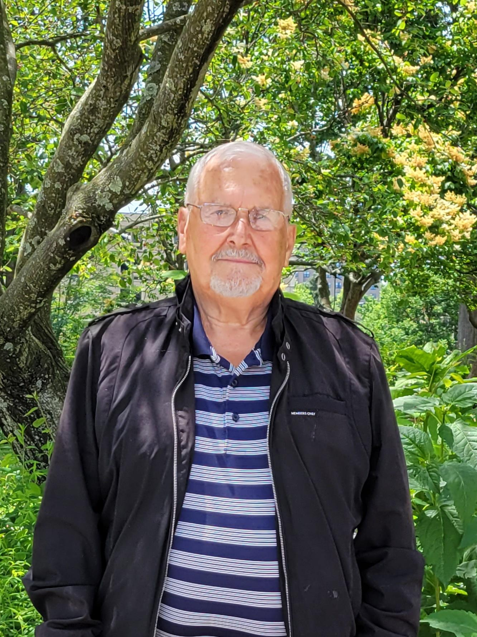
SONY BYERS
Department of Transportation
Bus Driver

Slide 9
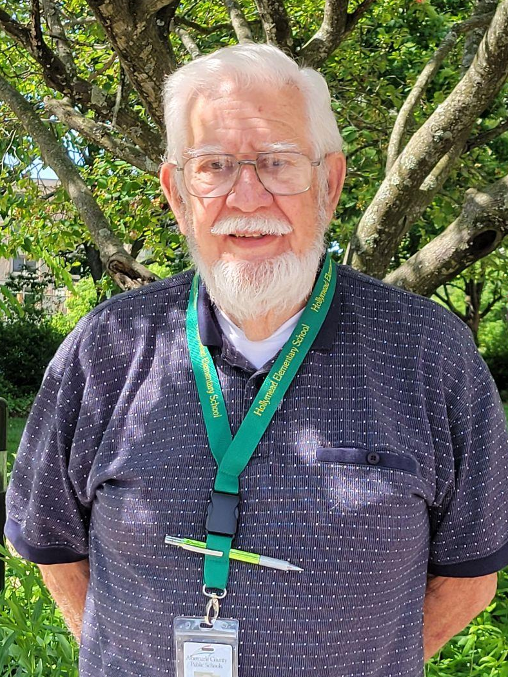
FRANK CHECCI
Department of Transportation
Transportation Assistant
“The last three years working with students in our special education program have been marvelous!”

Slide 10
DEBORA COLLINS
Deputy Superintendent of Instruction

Slide 11
ELIZABETH COOKE
Meriwether Lewis Elementary
Teaching Assistant

Slide 12
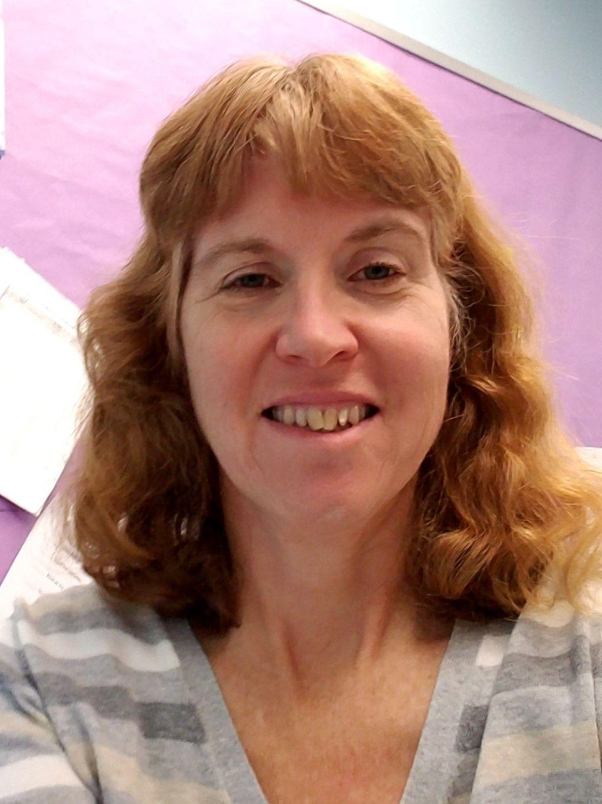
JEANNE D’ANTONI
Greer Elementary
Teacher
“The hardest kids need us the most.”

Slide 13
ELIZABETH DONAHUE
Blue Ridge Juvenile Detention
Special Education Teacher

Slide 14
FRIEDERIKE DUSSAUD-GARNIER
Woodbrook Elementary
Teaching Assistant

Slide 15
ELIZABETH EVANS
Lakeside Middle
Teacher

Slide 16
Ann Fox
Agnor-Hurt Elementary
Teacher

Slide 17
GARRY GIBSON
Department of Technology
Senior Technology Support Specialist

Slide 18
DIANE HARRISON
Special Education Department
Medicaid Specialist

Slide 19
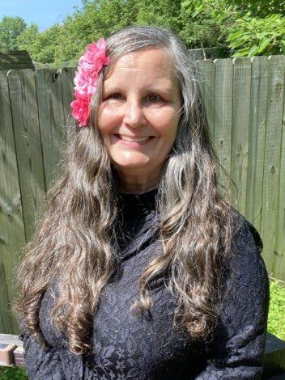
KIM HERMSMEIER
Mountain View Elementary
Teacher
“All I really need to know I learned teaching kindergarten!”

Slide 20
KELLI HUFFMAN
Woodbrook Elementary
Teacher

Slide 21
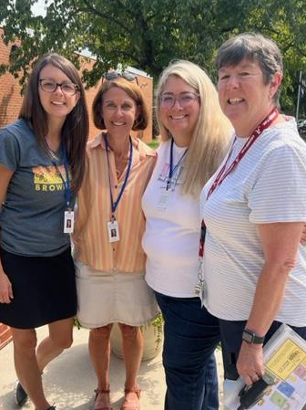
LOUISE HYDE
Brownsville Elementary
Teacher
Teachers have many roles to fill. Some are defined and others show themselves in other ways. The most memorable role for me has been with my awesome teammates planning lessons and activities for our students as a team. It’s been a great ride!

Slide 22
WALTER LEWIS JORDAN
Department of Transportation
Transportation Floor Supervisor

Slide 23
BETH KEITH
Mountain View Elementary
Teaching Assistant

Slide 24
VICKI KING
Child Nutrition Department
Program Supervisor

Slide 25
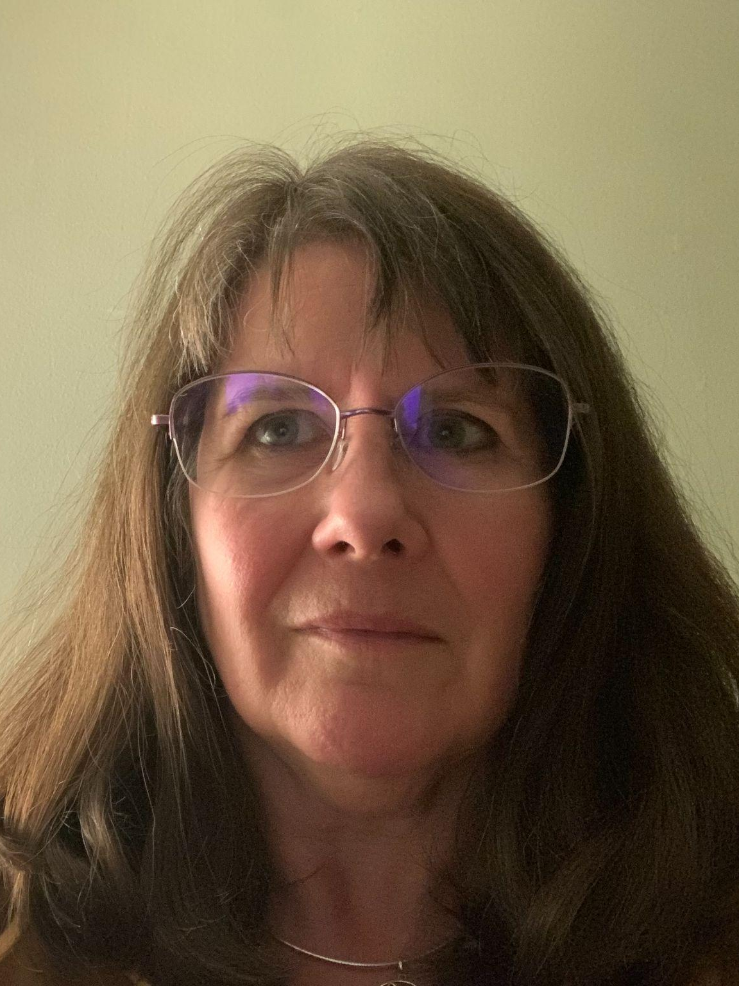
CHERYL KNIGHT
Murray Elementary
Teacher
You've gotta dance like there's nobody watching,
Love like you'll never be hurt,
Sing like there's nobody listening,
And live like it's heaven on earth.
― William W. Purkey

Slide 26
Deannine Lahham
Broadus Wood Elementary
Teacher

Slide 27
ANDRE LEWIS
Building Services Department
Custodian

Slide 28
DONNA LOWERY
Department of Transportation
Transportation Assistant

Slide 29
RANDALL MARSHALL
Building Services Department
HVAC Foreman

Slide 30
JENNY MARTIN
Special Education Department
Special Education Assistant

Slide 31
GILBERT MARTYN
Building Services Department
Carpentry-Maintenance Foreman

Slide 32
MELISSA MCREYNOLDS
Baker-Butler Elementary
Teacher

Slide 33
DEBORAH MURPHY
Child Nutrition Department
Food Service Manager

Slide 34
GLORIA OLIVER
Special Education Department
Special Education Teaching Assistant

Slide 35
LIZ PERKINS
Finance Department
Budget & Grant Analyst

Slide 36
LISA PORTER
Western Albemarle High School
Office Associate

Slide 37
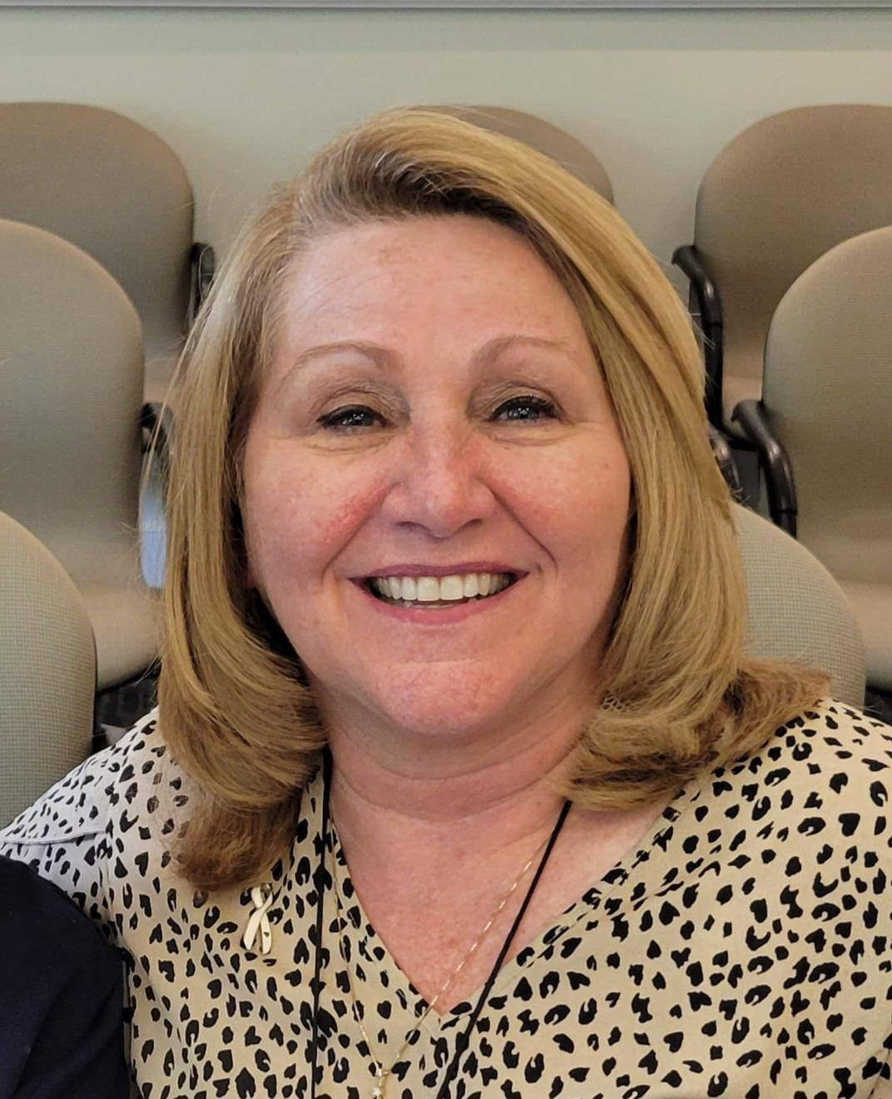
PAM POWELL
Department of Human Resources
Compensation Analyst

Slide 38
EDWARD REDMOND
Western Albemarle High School
Teacher

Slide 39
SUSAN REUSCHLING
Woodbrook Elementary
Office Associate and Bookkeeper

Slide 40
REBECCA RUSCHER
Brownsville Elementary
School Nurse

Slide 41
SALLY SARAH SAPP
Red Hill Elementary
Teaching Assistant

Slide 42
KERRY SHAFER
Albemarle High School
Teacher

Slide 43
JANICE SHIFFLETT
Department of Transportation
Bus Driver

Slide 44
KATHLEEN SHUPE
Baker-Butler Elementary
Teacher

Slide 45
VIRGINIA SMITH
EDEP
Community Education Registrar

Slide 46
PAM SNYDER
Building Services Department
Assistant Director for Custodial Services

Slide 47
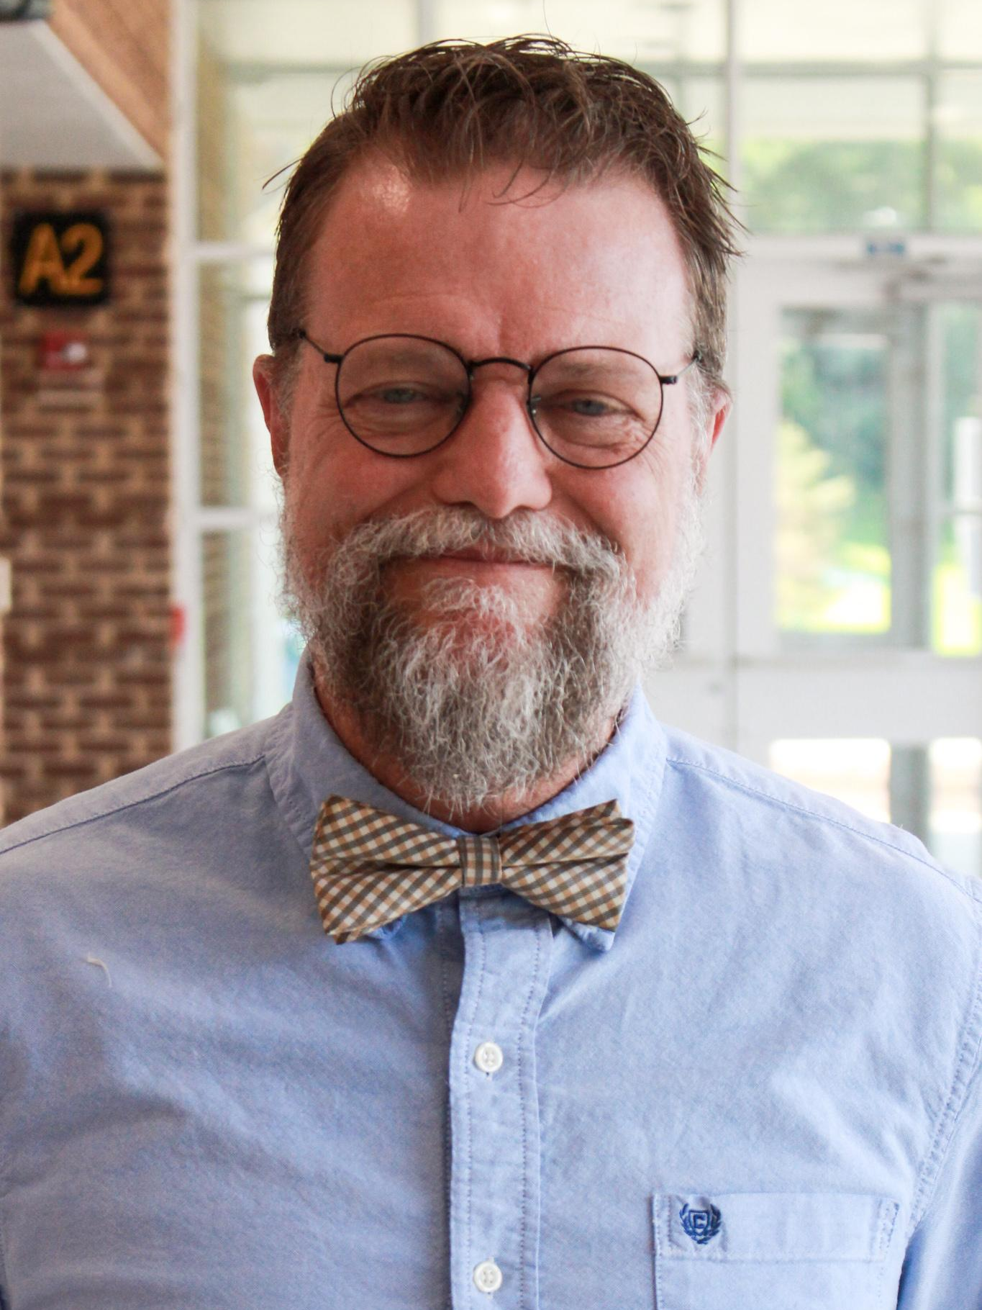
ART STOW
Scottsville
Interim Principal

Slide 48
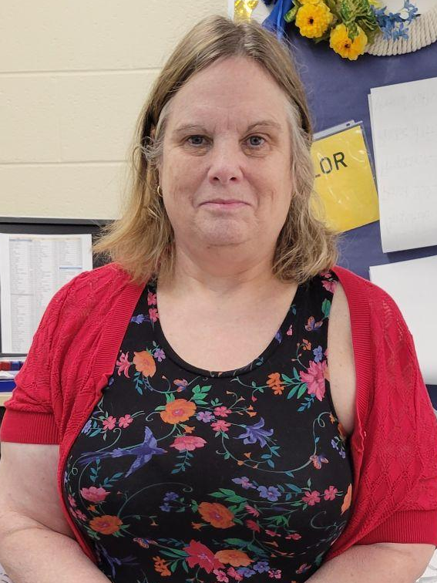
CARRIE TAYLOR
Western Albemarle High School
Teacher
“High school is learning about how you learn and not necessarily about what you learn.”

Slide 49
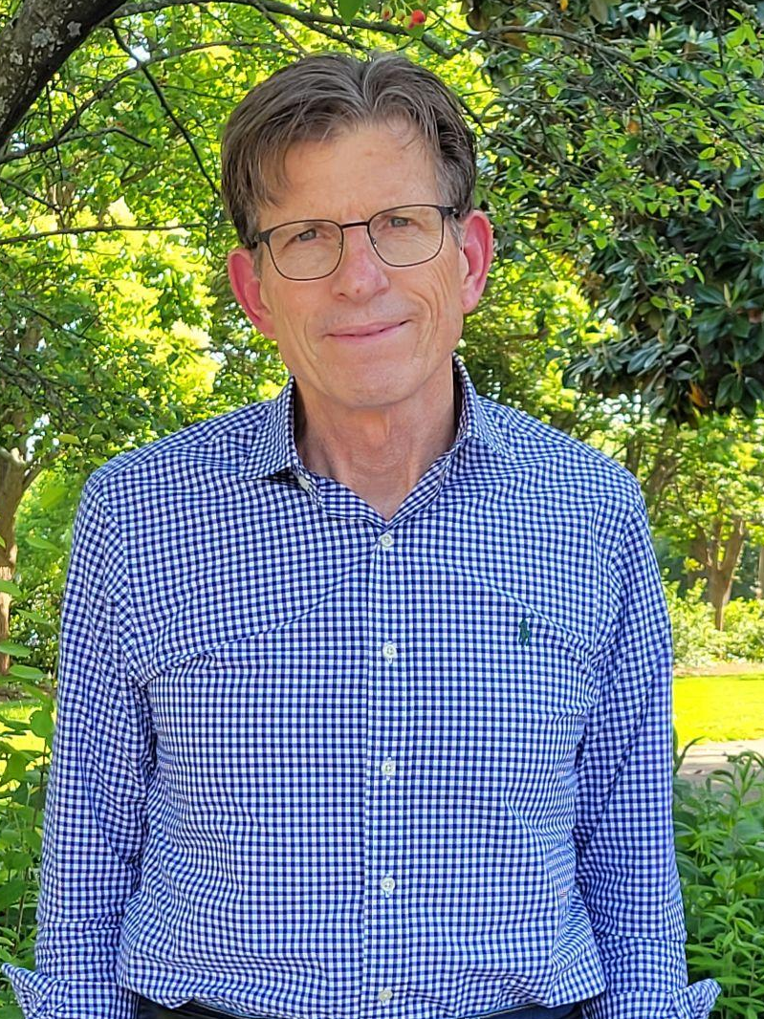
HENRY ‘TED’ THILL
Albemarle High School
Teacher

Slide 50
BEVERLY UPTON
Department of Transportation
Transportation Assistant

Slide 51
RICKY VRHOVAC
Human Resources
Principal on Special Assignment

Slide 52
SHIRLEY WALDO
Lakeside Middle
Food Service Manager

Slide 53
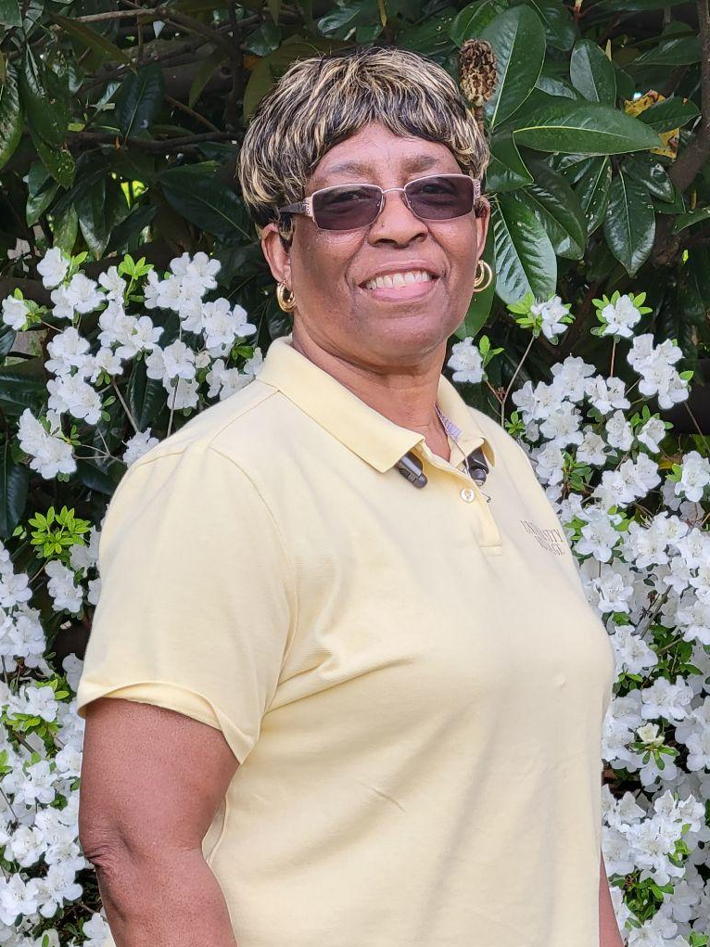
EDITH WALKER
Woodbrook Elementary
Custodian
“Seeing my kindergarten kids there to sing and the custodian team there to clean with a smile.”

Slide 54
DAVID WATERS
Monticello High School
Teacher
“On April 30, 2008, I was in Charlottesville with Will and we were closing on our home. I received a call from Billy Haun for an interview at Monticello. I told him I was not dressed for an interview: shorts and a t-shirt. He said come on and interview. I knew this was the right school system.”

Slide 55
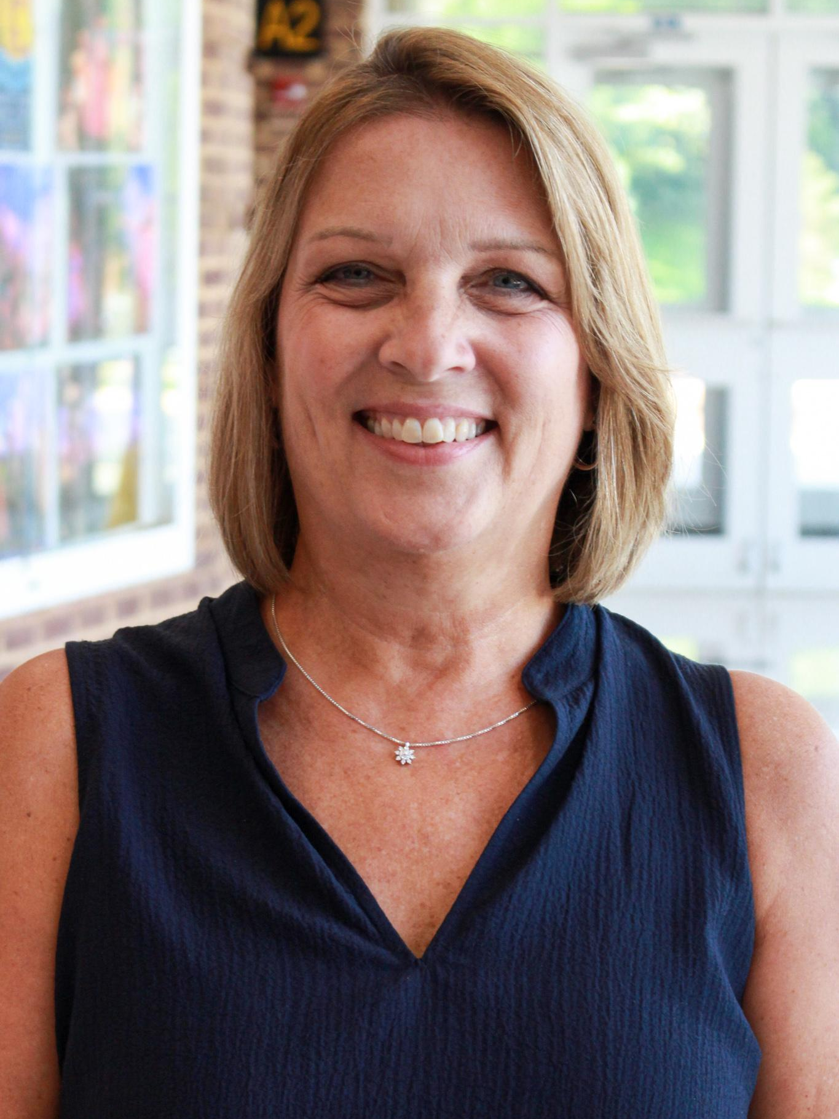
KRISTEN WILLIAMS
Woodbrook Elementary School
Principal
“Never stop listening, learning, and finding the joy in the work we are so fortunate to do each and every day in support of our ACPS students!”

Slide 56
DONNA LISA WRIGHT
Lakeside Middle
Teacher

Slide 57
for your dedication to Albemarle County Public Schools and its students over the years. Your contribution to local education cannot be overstated.

Slide 58
RETIREE NAME
School/Department
“This is a quote, words full of wisdom that someone important said and can make the reader get inspired.”

Slide 59
RETIREE NAME
School/Department

Slide 60

RETIREE NAME
School/Department
“This is a quote, words full of wisdom that someone important said and can make the reader get inspired.”

