Slide 1

Nursing and Health Services
Department of Student Services

Slide 2
Agenda
Topic
Include a small summary of information on topic
Topic
Include a small summary of information on topic
1
4
Topic
Include a small summary of information on topic
Topic
Include a small summary of information on topic
2
5
Topic
Include a small summary of information on topic
Topic
Include a small summary of information on topic
3
6

Slide 3



Strategic Plan: Learning for All
VALUES
Equity
Excellence
Family and Community
Wellness
GOALS
Thriving Students
Affirming and Empowering Communities
Equitable, Transformative Resources
VISION
Our learners are engaged in authentic, challenging, and relevant learning experiences, becoming lifelong contributors and leaders in our dynamic and diverse society.
MISSION
Working together as a team, we will end the predictive value of race, class, gender, and special capacities for our children’s success through high-quality teaching and learning for all. We seek to build relationships with families and communities to ensure that every student succeeds.
We will know every student.

Slide 4
Nursing and Health Services

Slide 5
ACPS Clinic
Visit Summary
Category | SY 22 - 23 | SY 23 - 24
Clinic Entries | 87254 | 105349
Daily Meds | 47985 | 51985
Employee | 1701 | 1804
Feeling Ill | 29500 | 33762
Major injury | 139 | 711
Major injury due to alter. | 10 | 14
Minor injury due to alter. | 614 | 706
Minor Injury | 22594 | 24466
Misc. visits | 23310 | 35608
Number of Days | 174 | 172
Parent Contact | 16398 | 13899
Referred to MD | 995 | 601
Repeat visit for injury | 1330 | 1409
Rescue Squad | 91 | 74
Sent home w/ lice | 59 | 256
Students given PRN Med | 7047 | 7023
Students sent home | 7367 | 7037
Virtual | 1068 | 649
Total | 121729 | 141496
Average | 699.592 | 822.6512

Slide 6
ACPS Vision Screening Results
Grade | Students Screened | Referred for suspected deficit | Were Seen by Provider | Diagnosed
K | 790 | 76 or 9.6% | 27 (9.6% of total; 36% of referrals) | 19
3 | 865 | 86 or 10% | 37 (4.3% of total; 43% of referrals) | 30
7 | 980 | 232 or 24% | 13 (1.3 % of total; 24% of referrals) | 13
10 | 815 | 203 or 25% | 15 (2 % of total; 7.4% of referrals) | 10
Total | 3450 | 597 | 92 | 72

Slide 7
School Health Entrance Requirement Work
Health department no longer offering walk-in immunization clinics
Shortage of available medical appointments for physical exams and immunizations particularly as the first day of school approaches
Large coordinated effort to raise compliance this year
  Parents/guardians required to submit records or proof of appointment
  Students excluded from school if documentation not provided
  Offered several school-based clinics – 1 at each high school and 2 at Woodbrook

Slide 8
COVID Protocol in Alignment with CDC
Guidance is now to treat COVID as any respiratory virus
  Remain out of school until fever-free for 24 hours without the use of fever reducing medication
  Symptoms have improved overall
  No longer tracking cases in ACPS

Slide 9
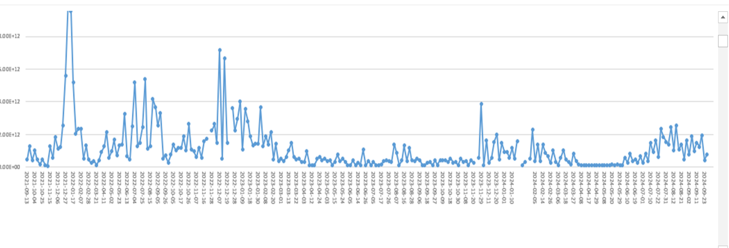
Moore’s Creek SARS-CoV-2 Viral Loads in Wastewater
9/13/2021 – 9/25/2024

Slide 10
CDC Interpretation of Viral Load in Wastewater
The wastewater viral activity levels are categorized as follows:
  Up to 1.5 – Minimal
  Greater than 1.5 and up to 3 – Low
  Greater than 3 and up to 4.5 – Moderate
  Greater than 4.5 and up to 8 – High
  Greater than 8 – Very High
Highpoint on Chart 1/17/2021 over 10
For more information see the VDH
  Unit is viral gene copies per liter. This surveillance is intended for comparison over time rather than a predictor of number of cases on a given day or time period.

Slide 11
Community Partnerships to Serve Students
Mill Creek Orthodontics
  Donated Life Vac devices for all schools
Sentara Grant
  Provide dental care for students
Pediatric Associates/BRHD
  Central Virginia Children’s Wellness Initiative
Blue Ridge Health Department
  Vaccine clinics at all 3 high schools in August
UVa - Immunization Clinic at Woodbrook Elementary
UVa Latino Health Initiative and Dept of Health Equity
  Sports Physicals

Slide 12
School Health Advisory Board
School Health Entrance Requirements
  Approve of effort to increase compliance rates
Chronic Absenteeism
  Support Division’s efforts to address issue
  Approved of illness criteria for temporary school exclusion due to illness
Governor’s Exec Ord.er 28: Notification of Opioid Overdose
  Helped define overdose
  Approved overdose protocol
  Approved Narcan placement at all schools
  Support educational sessions for school staff, families and students

Slide 13
School Health Advisory Board
Student Wellness Policy Triennial Review
  Provided feedback to all components of the policy
Student Mental Health
  SHAB members are concerned about pediatric mental health and primary care providers support increasing school-based services
  Support effort to maintain social emotional coaches and any other personnel assigned to work with students experiencing difficulties
  Recommend incorporating mindfulness into the school day
  Strongly support cell phones being away for the day

Slide 14
Questions/Discussion

